Slide 1
Team Antenatal
Courtney, Cody, Phil, Abbas, Thad

Slide 2
What is our group supposed to do?
Be able to make a full data entry of antenatal care information/report.
In iterations 1 and 2 this was commandeered as the Record class, but in iteration 3 the Record class was dissolved and instead merged into the Mother class.
Be able to make monthly midwife report.
In all iterations this was regulated in the Midwife class.
Group:
Leader: Courtney
Paired Programmers: 1. Cody & Phil 2. Abbas & Thad

Slide 3
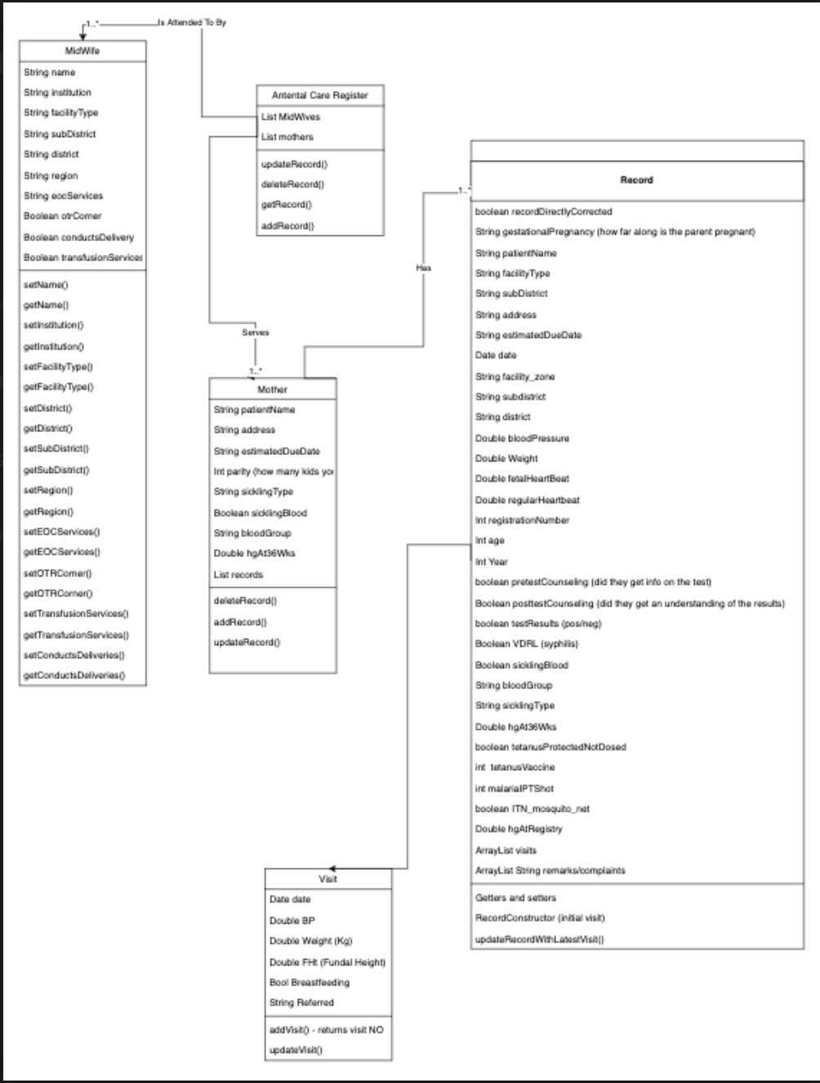
Most Recent UML Diagram
This UML diagram demonstrated the initial class setup for iteration 1 and less so for iteration 2. Iteration 3’s UML has not been made/updated.
Classes:
Record (iter 1, 2)
Mother
Midwife
Visit
AntenatalCareRegister (iter 1)
UI (iter 2-3) - manages the GUI

Slide 4
Use Cases
Most use cases made involved successfully making changes to either midwife or mother object as a result of other changes.

Slide 5
Record/Mother.java
This class holds antenatal information about the mother.
Class was made using the Ghana Health Service Antenatal Care Register pdf.
Can use MotherPDFReader.java to create a Mother object.
The pdf holds an area for future visits so it is necessary to make a visit class.

Slide 6
Midwife.java
This class holds the information of the midwife.
Class was made using the monthly midwife report pdf.
Can use MidwifePDFReader.java to create a midwife object.

Slide 7
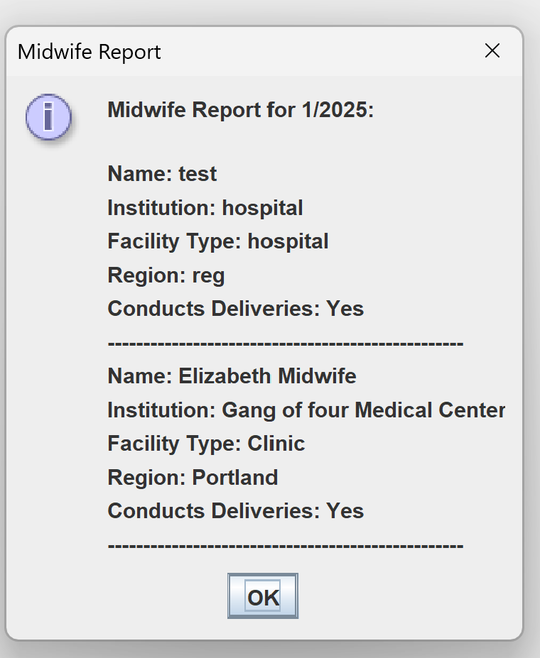
GUI
The GUI is a very basic implementation with minimal functionality. It contains 4 buttons:
Add Mother Visit
Add Midwife Record
Print Mother Report
Print Midwife report
Features:
Manual or PDF entry may be selected to add
a record.
Mother records are searchable by name and ID
Midwife records are searchable by year and
month of entry

Slide 8
Visit.java
The purpose of this class is to update information in the Record/Mother.java class.
Class was made using the visit section from the Ghana Health Service Antenatal Care Register pdf
Record/Mother.java holds a list of Visit objects and updates information based on the newest visit created and added to the list.

Slide 9
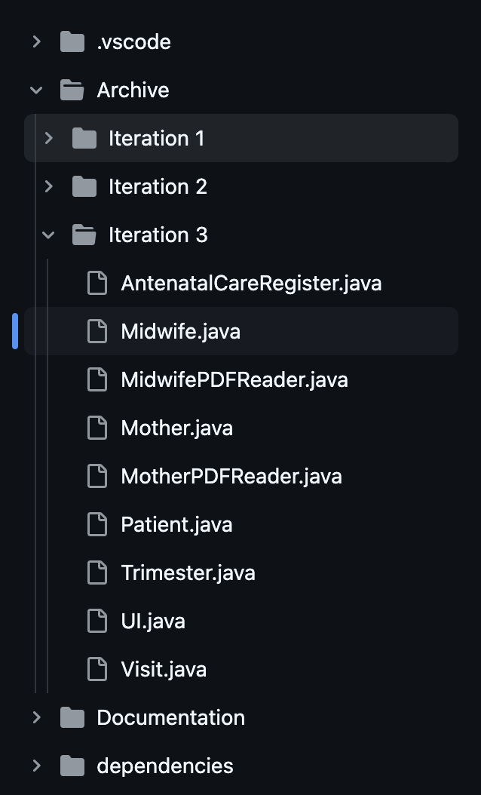
Github Overview
Link: https://github.com/CourtOfTheKnee88/Team-Antenatal/tree/main
Archive holds each iteration files in their own folder.
Branches for each team member are accessible.

Slide 10
Strengths and Weaknesses of Entire Project
Strengths:
Communication via. Slack
Role placement
Weaknesses:
Paired Programming
Uncertain expectation of what the final product should look like.

